Slide 1
Revelio: A Perception Effectiveness Assessment Approach for Graphical Patterns in Charts
Submission ID: 1415

Slide 2
Introduction of Concepts
Concepts | Introduction
Visual effect | Visual impact of chart elements (position, size, color) that influences how viewers perceive information.
Visual encoding | Mapping data to visual properties (color for categories, bar height for values) to enhance readability.
Patterns | Structures formed by visual elements (trends, clusters, color groupings) that reveal data relationships.
Perception Scope | Range of visual elements being perceived, adjustable based on user selection.
Visual salience | How strongly a visual element attracts attention; helps identify which patterns viewers notice first.
Variance | Statistical measure of distribution in visual effects; high variance means diverse effects.
Bbox | Bounding box surrounding elements, used to evaluate positional importance.
HSL | Color model using Hue (color type), Saturation (intensity), and Lightness (brightness) to optimize visual prominence.

Slide 3
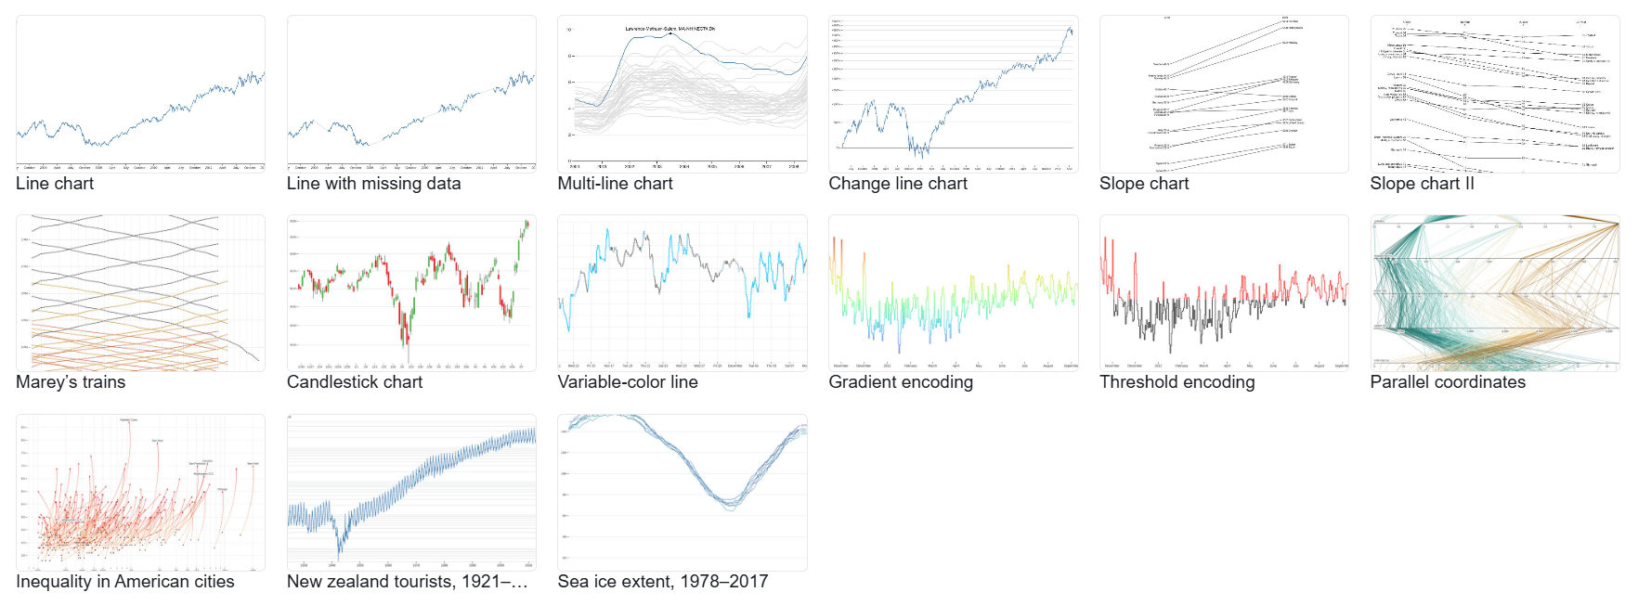
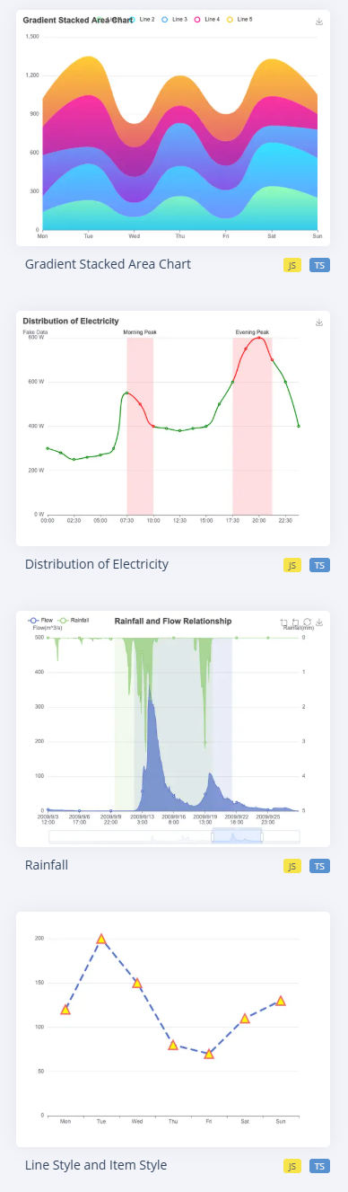
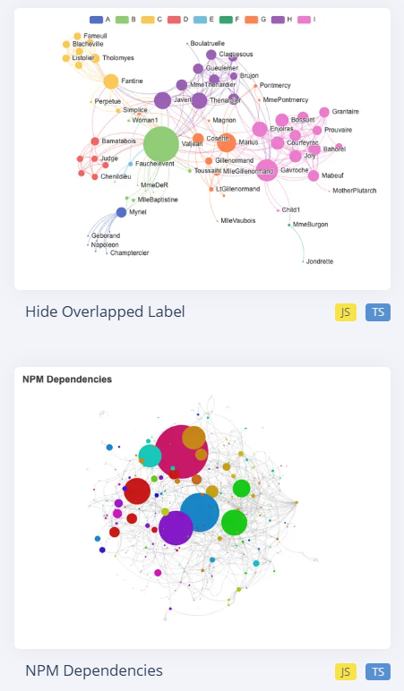


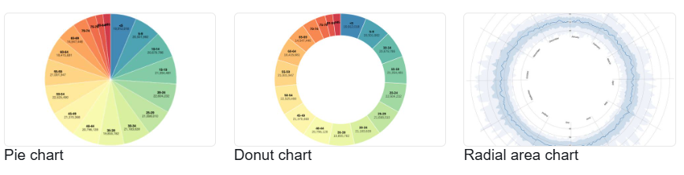
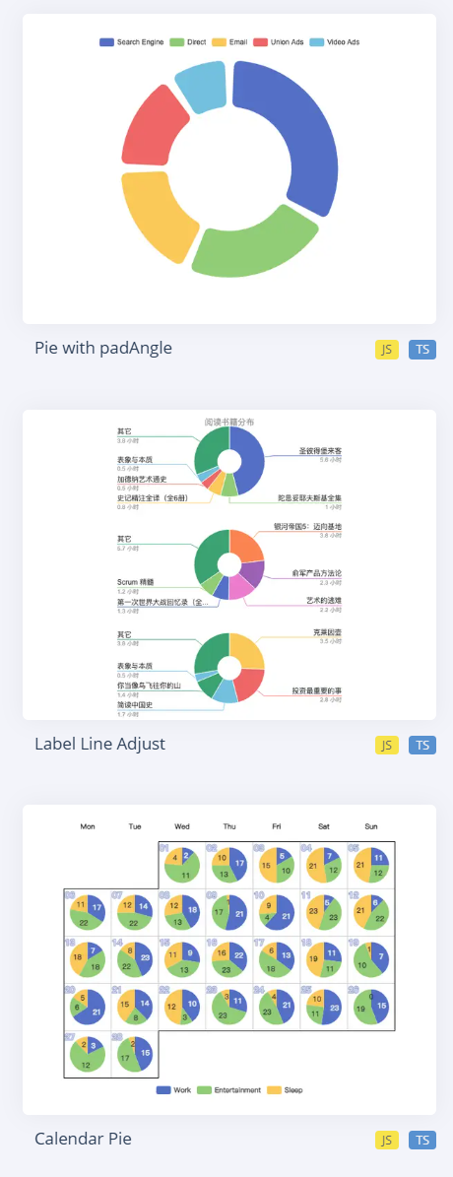
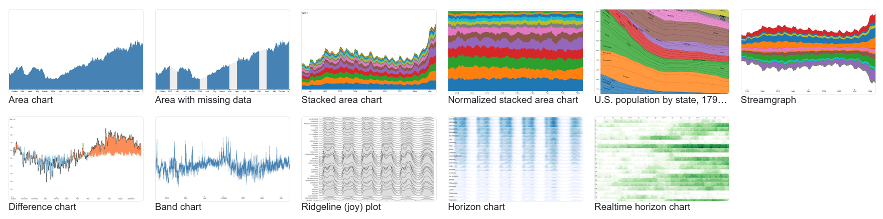

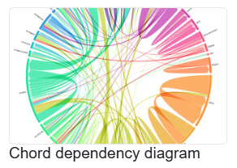
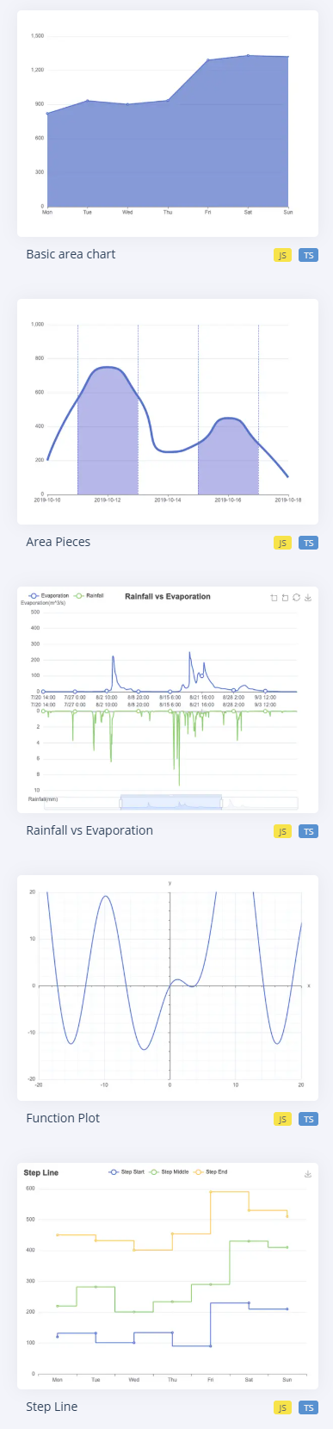

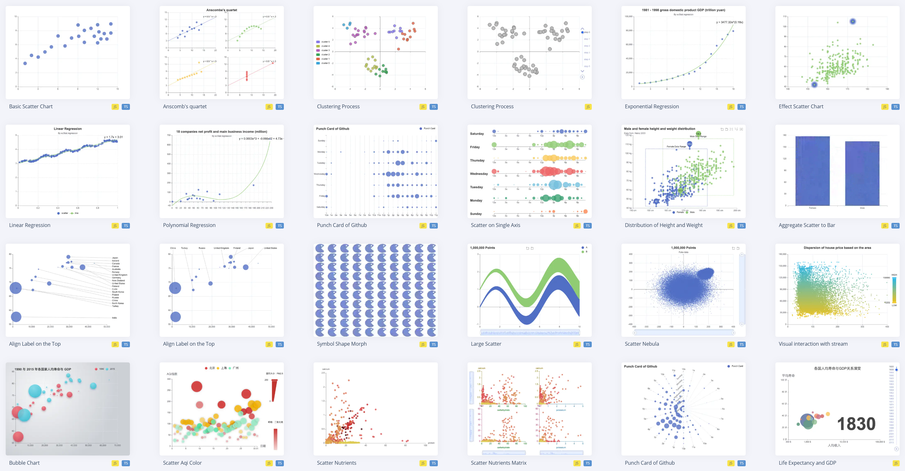
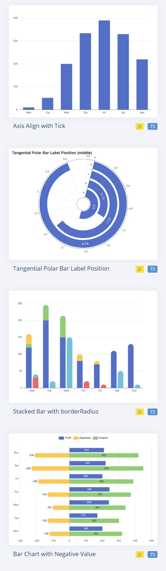
Creating charts is no longer difficult.
D3
ECharts
Highcharts
Chart.js
Chart authoring tools
Chart templates

Slide 4
But how to make a choice?
D3
ECharts
Highcharts
Chart.js
Chart authoring tools
Chart templates

Slide 5
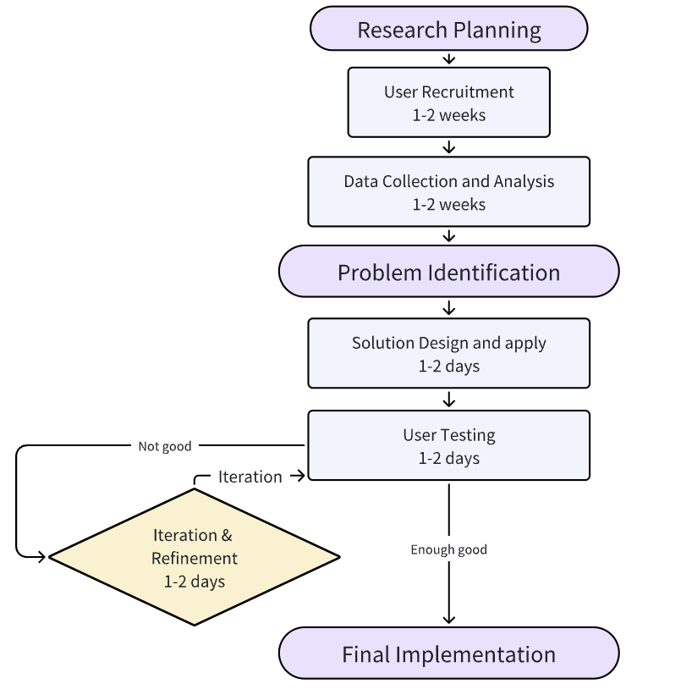
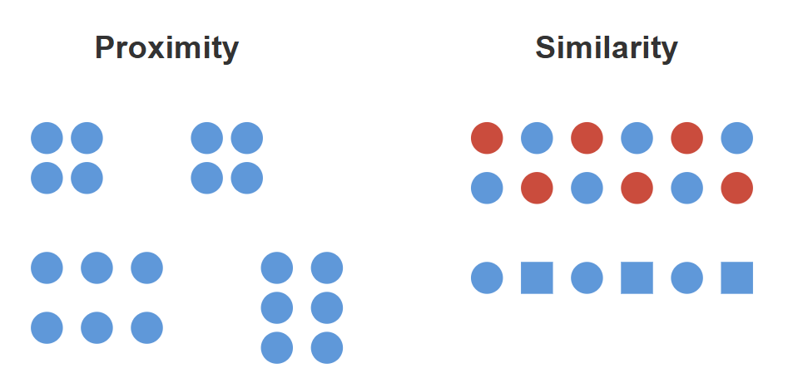
Assessing the representation effectiveness of charts is difficult.
Time-consuming
Hard to apply
User studies
Perception theories
https://huangruilin.tw/2015/08/20/visual-principles-gestalt-theory-4-fundamentals/
Notes:
it is challenging to determine whether others can discern the message the author intends to convey through the chart.

Slide 6
Contributions
A graphical pattern identification approach for charts, which simulates human perception by integrating Gestalt Principles.
A prototype interface allows chart authors to assess their chart design and get suggestions.

Slide 7
Design Goals
Identify graphical patterns based on visual perception of humans.
Simulate common perceptual behaviors.
Include diverse perceptual results.
Explain the perceptual mechanism.
Correlate visual effects with graphical patterns.
Compare visual effects of elements.
Suggest improvements for visual representation.
Analyze the current representation effects.
Recommend visual design for representing user-specified patterns.

Slide 8
Our Approach
Perception Simulation Formulation
Visual Effects Description
Chart Assessment
Graphical Patterns Identification
Perception Simulation Formulation
Visual Effects Description
Chart Assessment
Graphical Patterns Identification

Slide 9
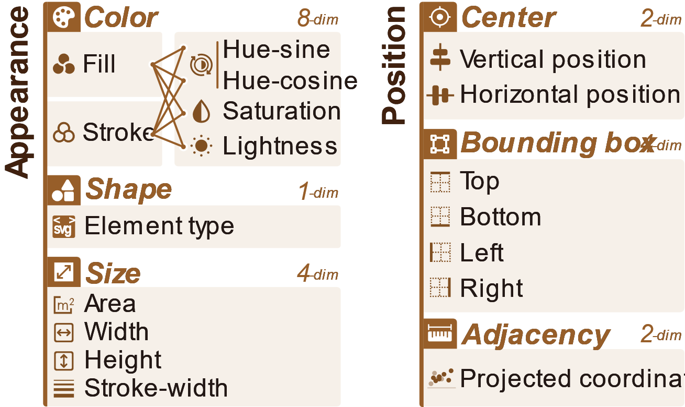





Our Approach
SVG code
<rect>
<circle>
<path>
Dissemble visual elements
Characterize visual effects
Perception Simulation Formulation
Visual Effects Description
Chart Assessment
Graphical Patterns Identification

Slide 10
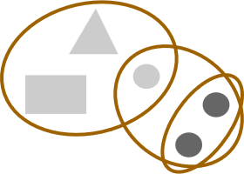



Our Approach
Positive
pairs
Contrastive
learning model
Perceptual
features
Group
annotation
Negative
pairs
{F，F，…
Inject perception patterns
Extract perceptual features
Perception Simulation Formulation
Visual Effects Description
Chart Assessment
Graphical Patterns Identification

Slide 11
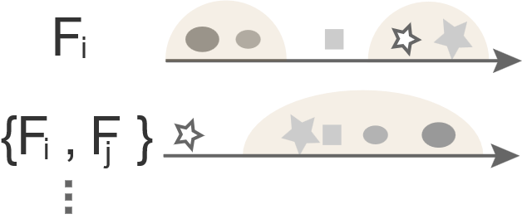
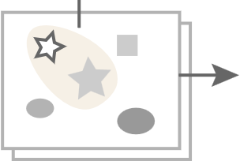
Our Approach
Graphical pattern
Similarity
Within
High
Chart
In/out
Low
Group visual elements
Measure pattern salience
Perception Simulation Formulation
Visual Effects Description
Chart Assessment
Graphical Patterns Identification

Slide 12
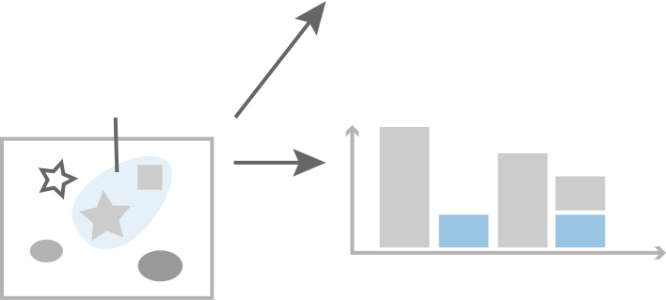
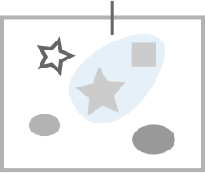

Our Approach
Selected
element
group
Salience score
Expected
pattern
Suggestion:
#Elements
Add a new
channel
(e.g., hue)
Visual effect
Support pattern exploration
Suggest design improvement
Perception Simulation Formulation
Visual Effects Description
Chart Assessment
Graphical Patterns Identification

Slide 13
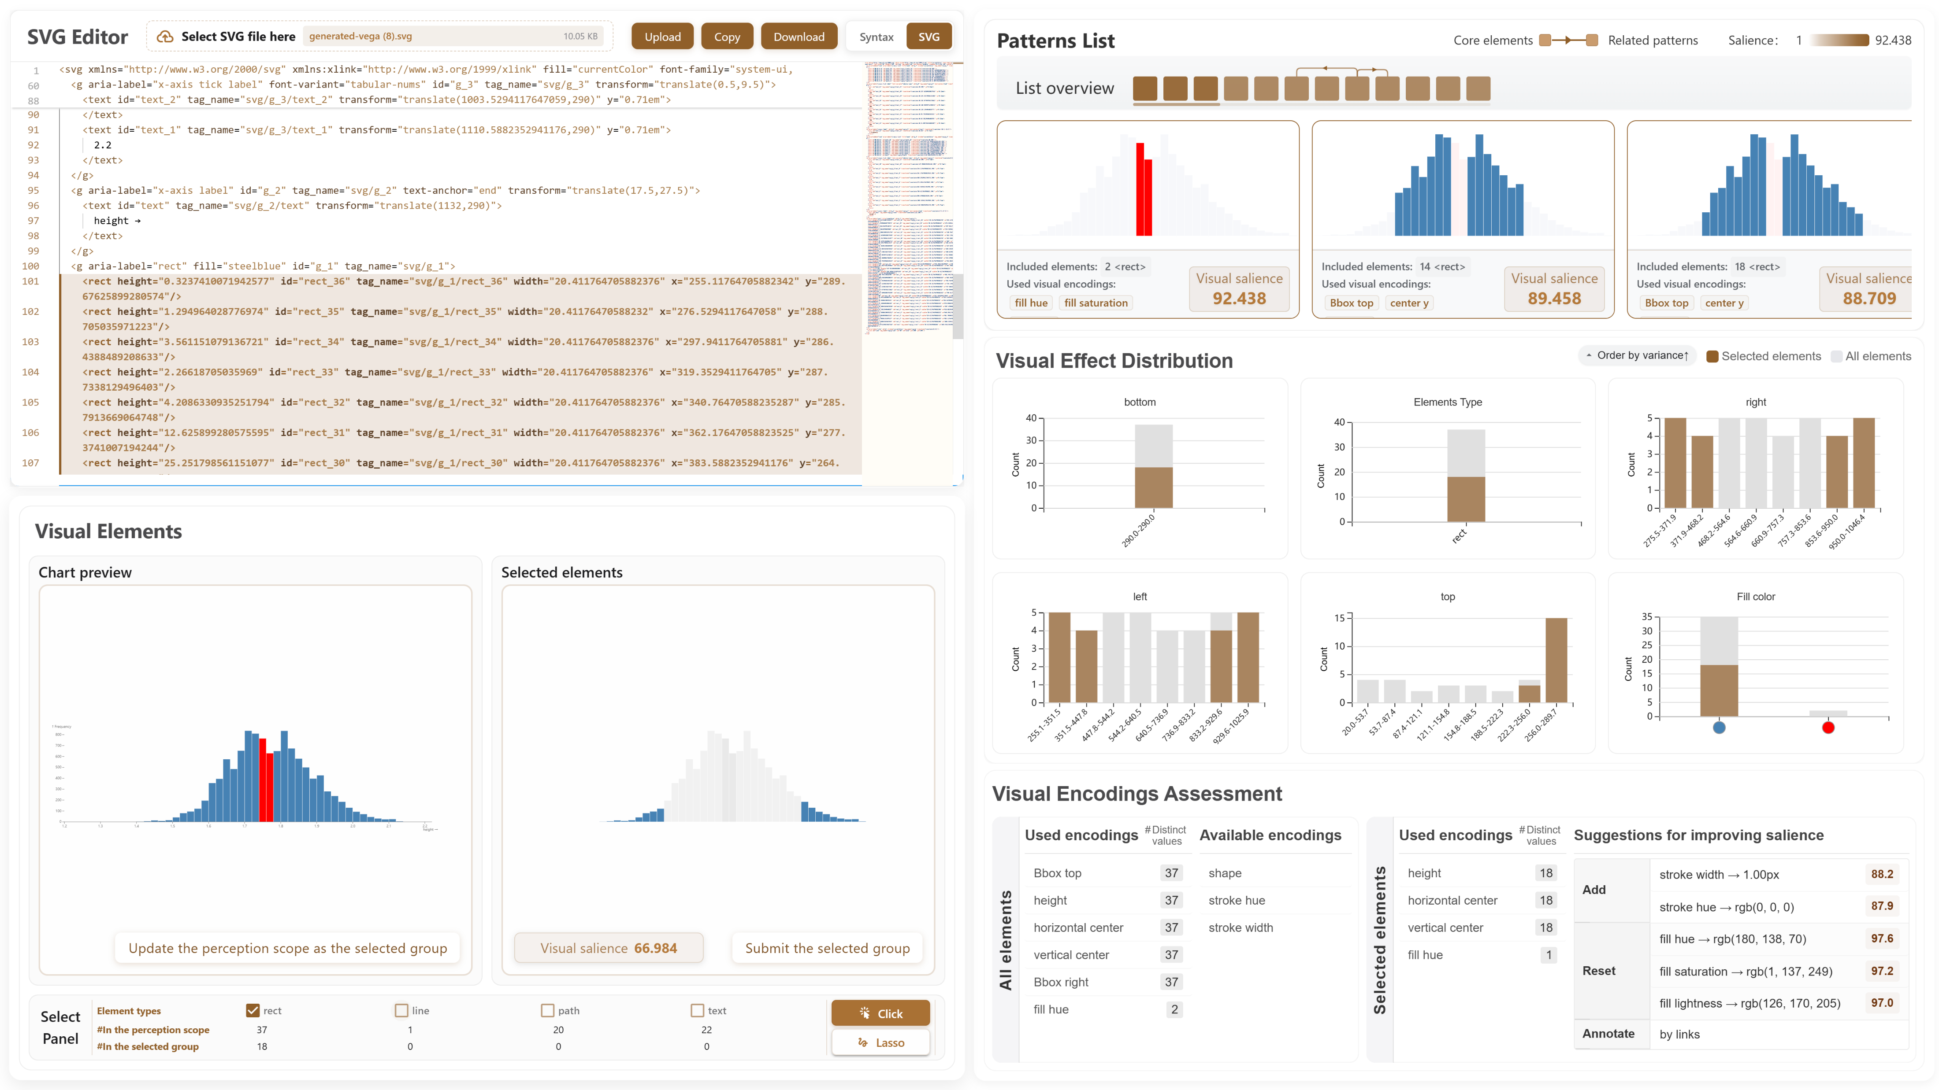
Interface

Slide 14
Interface

Slide 15
Interface

Slide 16
Interface

Slide 17
Interface

